Slide 1

Myntra website presentation
Presented by:
Avdhesh Kumar(Aiml)
Shailendra shukla(Aiml)
Ritesh Gupta(Aiml)

Slide 2

Beginning of
Started: February 2007.
Myntra.com is an Indian online shopping retailer of fashion and casual lifestyle products.
Headquarters in Bangalore.
Myntra was established by Mukesh Bansal, Ashutosh Lawania, and Vineet Saxena in February 2007.
In the last 3 years, Myntra has become the most popular destination for personalized product in the country.

Slide 3






Save Money
24/7 Support
Online Order
Happy Sell
Free Shipping
Promotions

Slide 4



Software Requirements
CODE EDITOR
HTML ( Hypertext Markup Language )
CSS ( Cascading Style Sheets )
VS CODE (VISUAL STUDIO CODE)

Slide 5
Modules
1
HOME
2
BAG
3
SIGN UP
ECOMMERCE
WEBSITE
4
LOGIN
5
PROFILE
6
WISHLIST

Slide 6

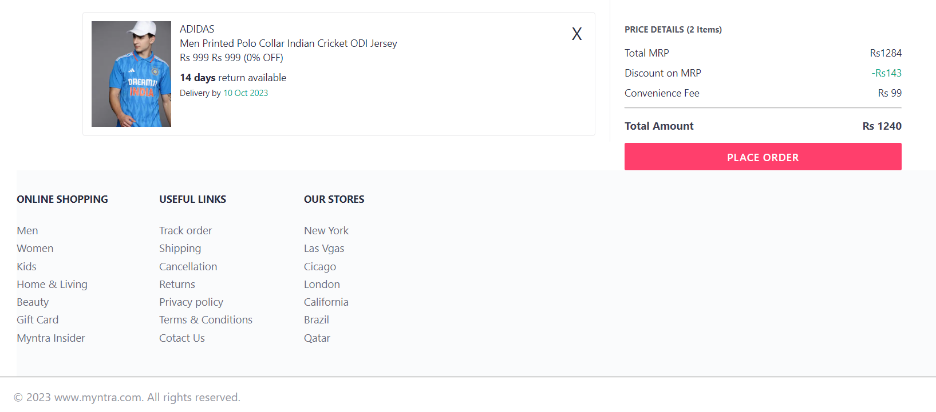
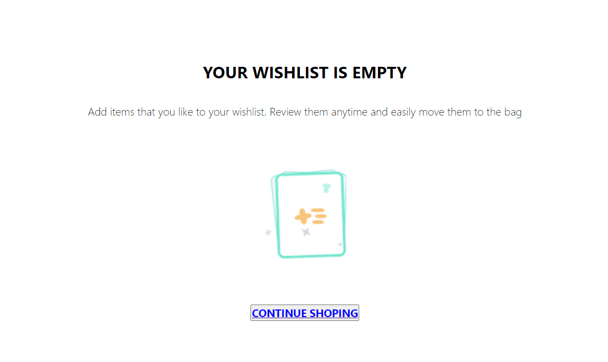
1
HOME
2
BAG
3
WISHLIST

Slide 7
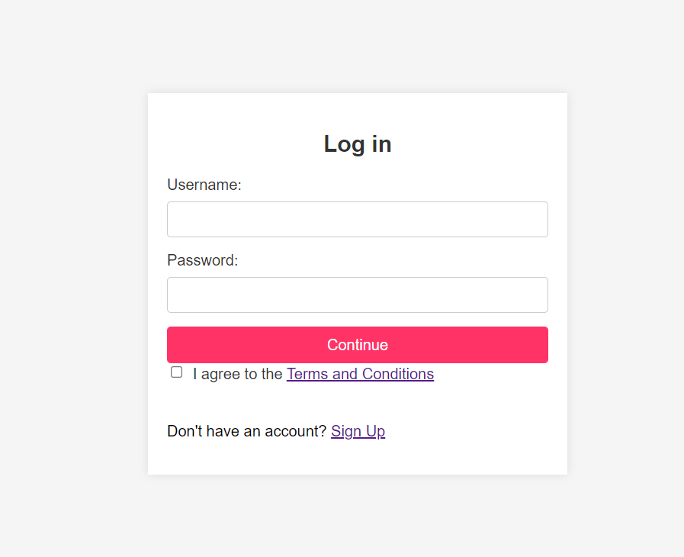
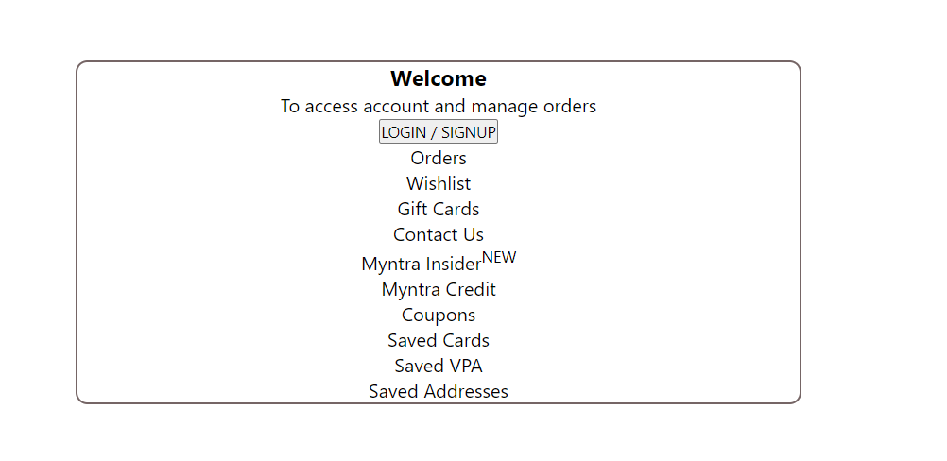
4
LOGIN
5
PROFILE

Slide 8
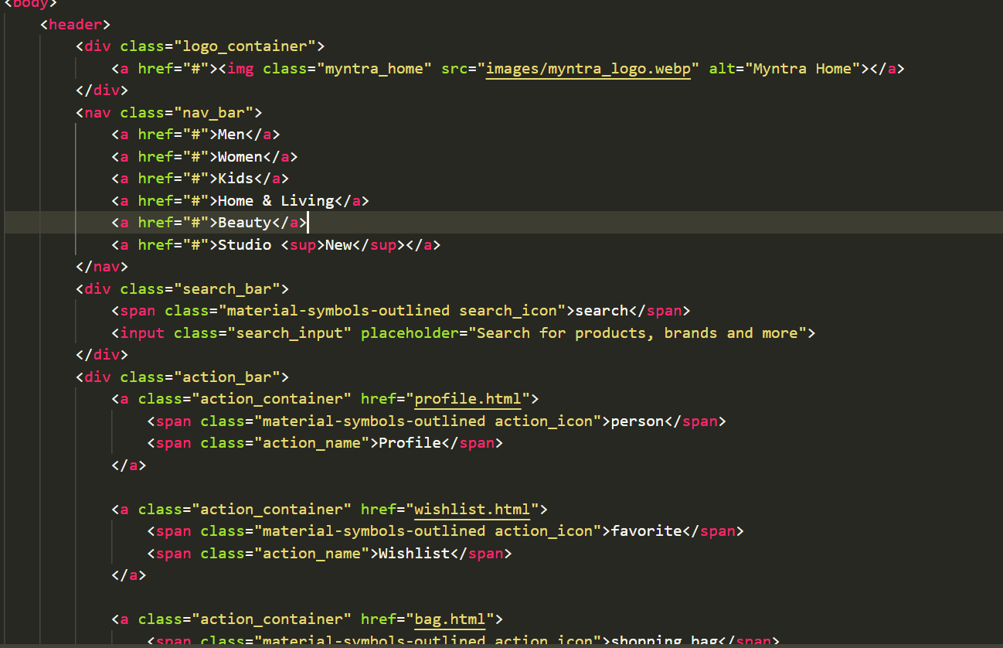
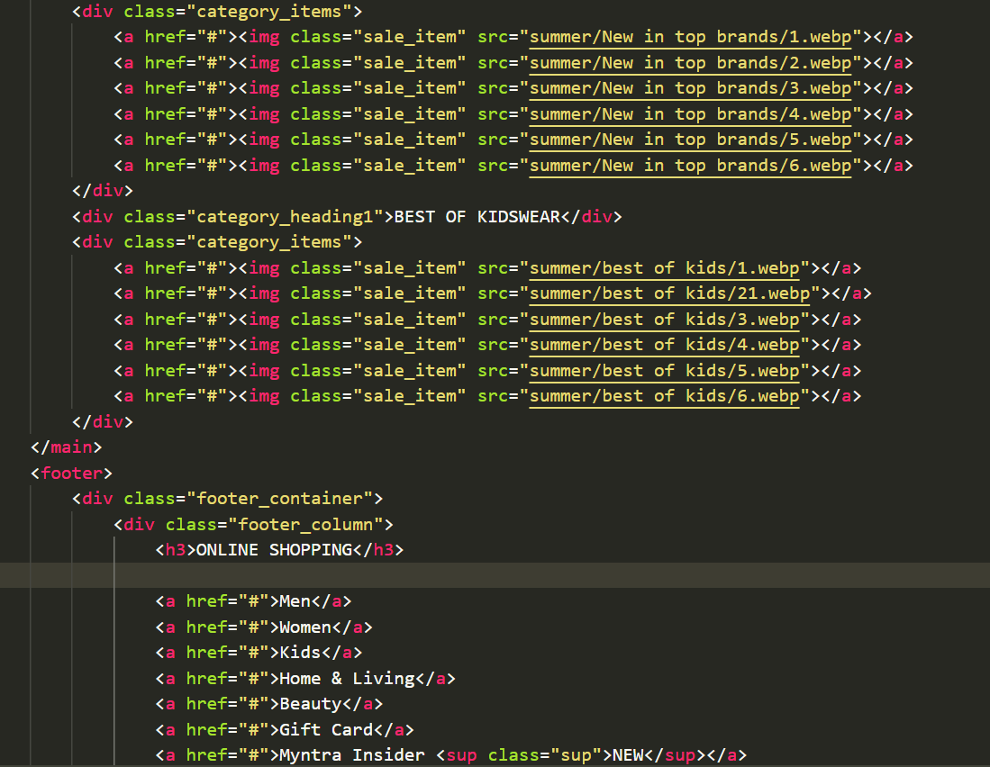
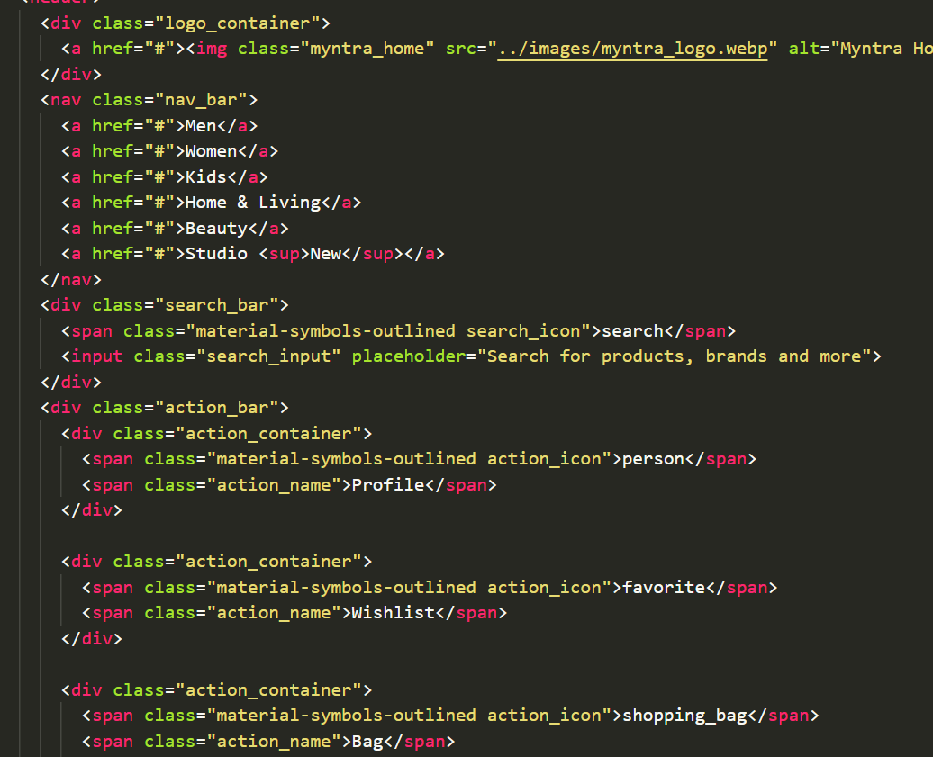
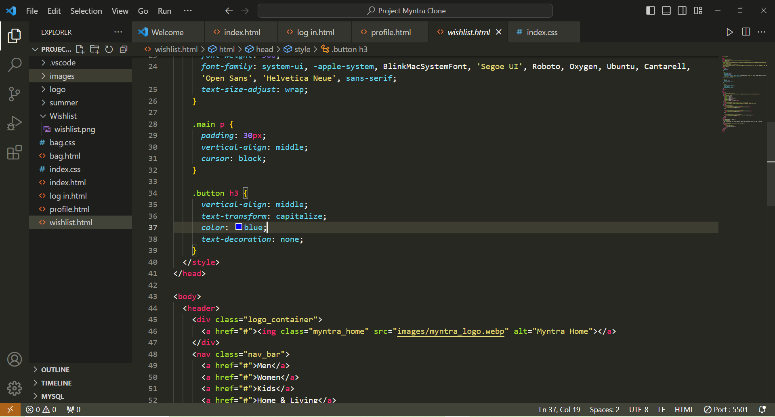
CODING

Slide 9
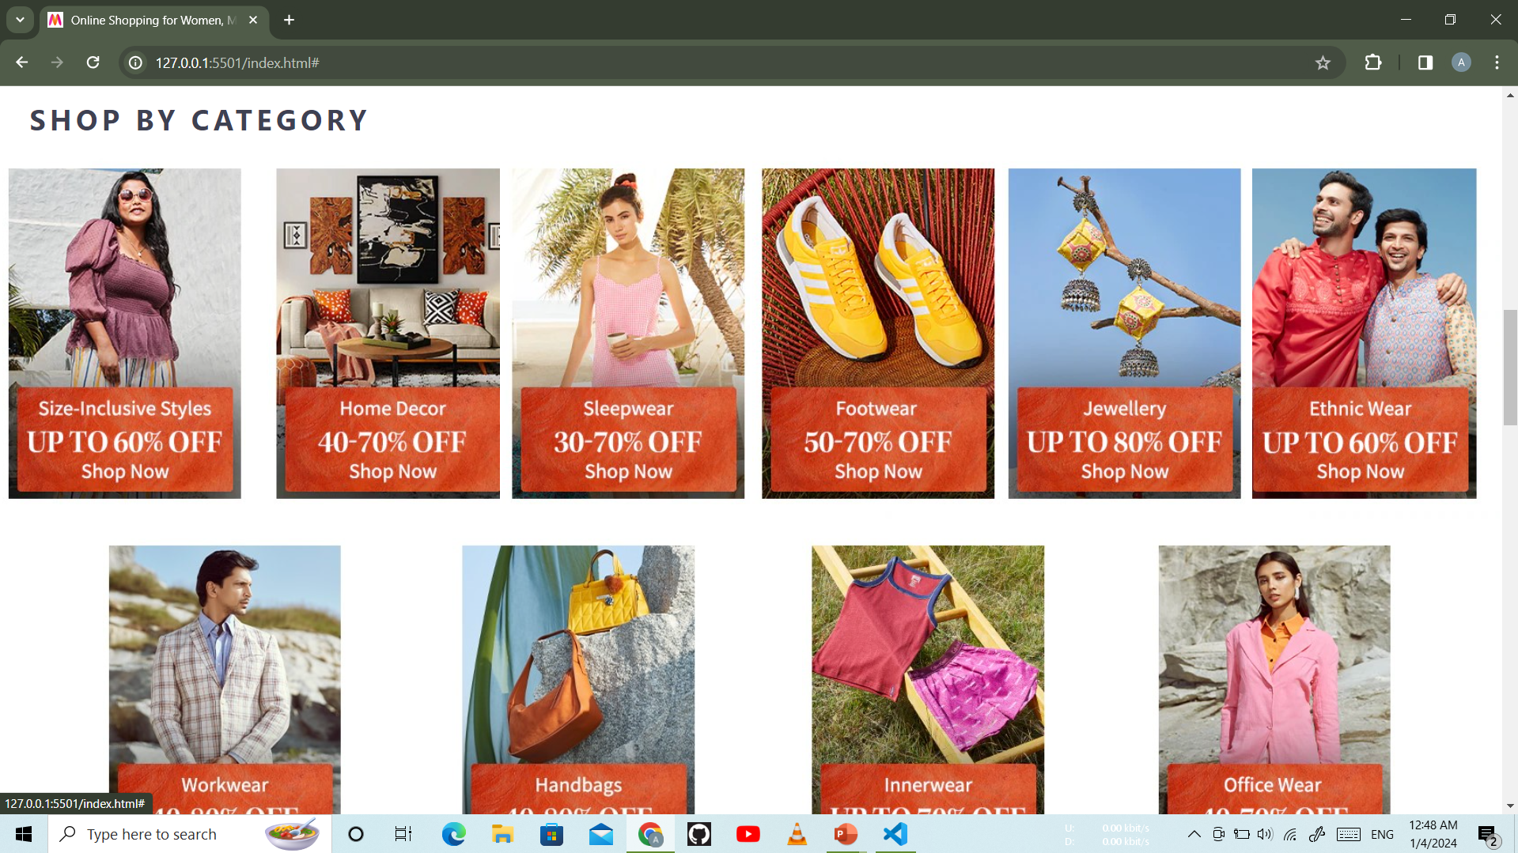
SCREENSHOT OF MYNTRA WEBSITE

Slide 10
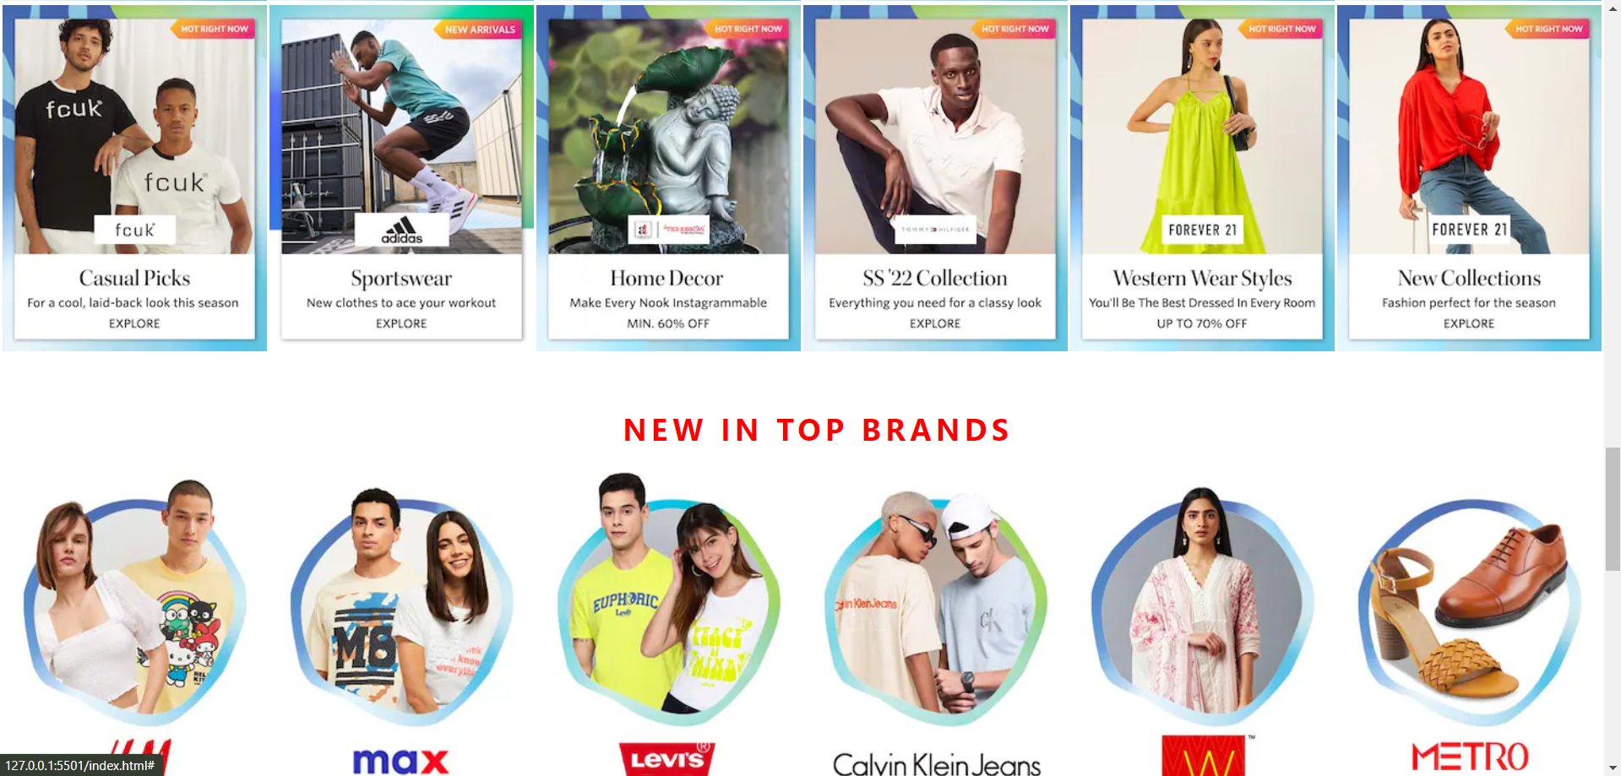

Slide 11
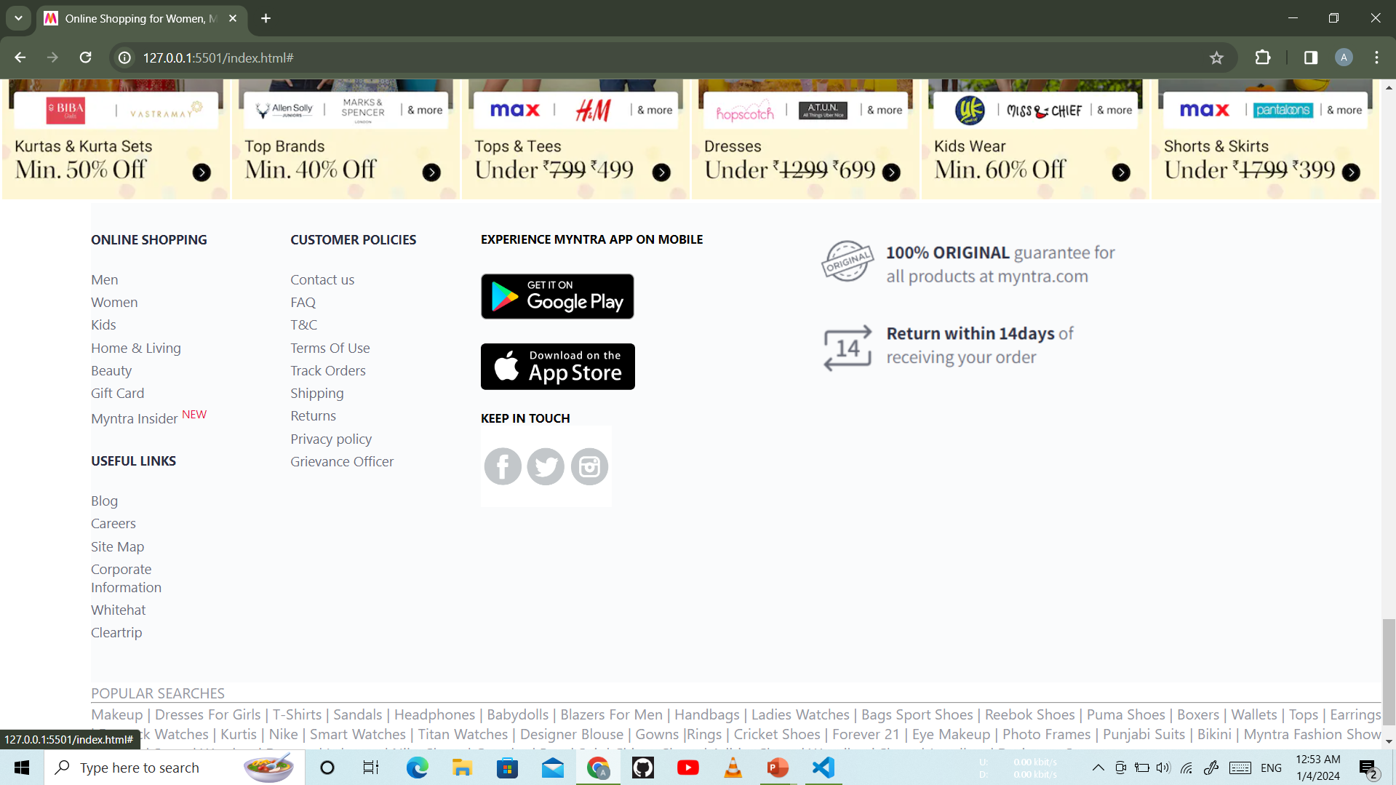
SCREENSHOT OF FOOTER PAGE

Slide 12
Future plan
I thinking of some modifications and adding some advanced new features in system some of them are –
GUI modification (more user friendly)
Users can sell their product
I will learn Mongo db, Express js, React js and Next js as well as java script to improve my website.
I will try to make this website as highly secure website and using Bkash or others mobile banking API

Slide 13
Thank You
THANK YOU

